Slide 1
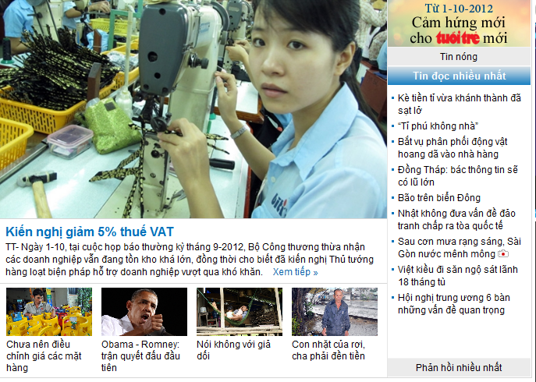
Exercise
You have permission to reuse content and CSS in Tuoitre newspaper to design the page exactly as figure but in simple html document.
Copying document from tuoitre will get 0 mark.
Notify me when you finish your work to get mark

Slide 2

Exercise
You have permission to reuse content and CSS in Golive website to design the page exactly as figure but in simple html document.
Copying document from Golive will get 0 mark.
Notify me when you finish your work to get mark

Slide 3
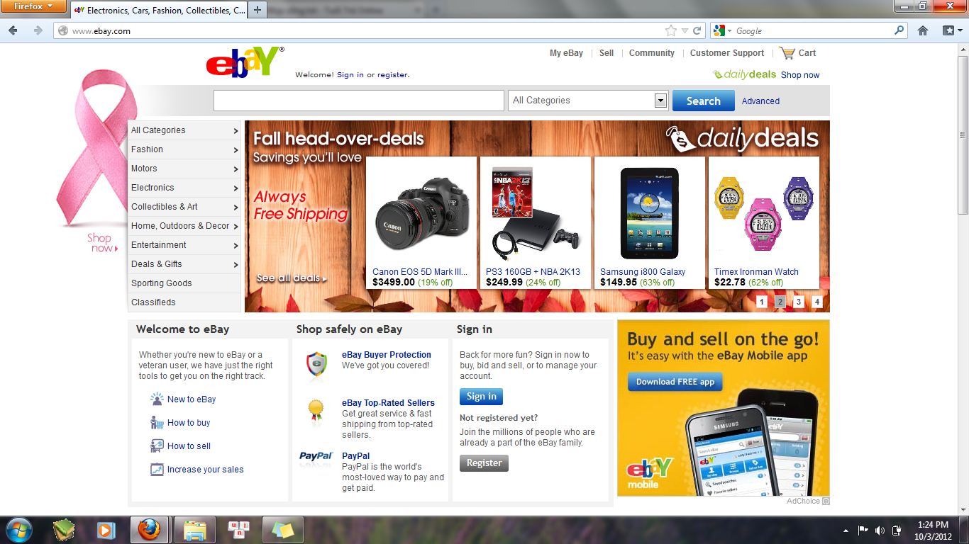
Exercise
You have permission to reuse content and CSS in Ebay website to design the page exactly as figure but in simple html document.
Copying document from Ebay will get 0 mark.
Notify me when you finish your work to get mark

Slide 4
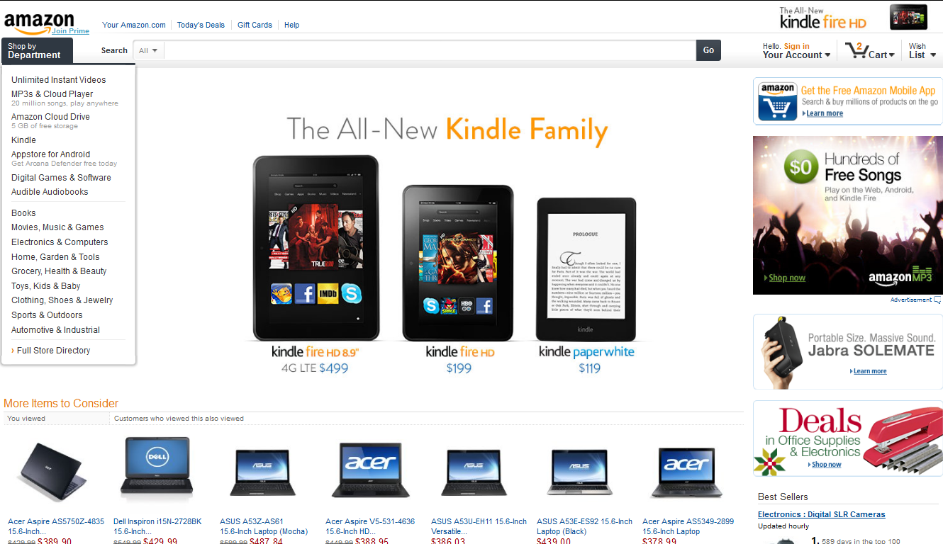
Exercise
You have permission to reuse content and CSS in Amazon website to design the page exactly as figure but in simple html document.
Copying document from Amazon will get 0 mark.
Notify me when you finish your work to get mark

